Slide 1
Presentation on Cloud Computing
Presented By:- Guided By:-
Shikhar raturi Dr. Preeti malik
BCA 6A (Professor)
MCA Department

Slide 2
Contents:-
What is Cloud Computing?
Why Cloud computing?
Cloud Computing Architecture
Types of Cloud computing
Deployement Model
Service Models
Advantages and Disadvantages

Slide 3
What is Cloud Computing?
Cloud Computing is the delivery of
on-demand computing services
over the internet on a
pay-as-we-go basis

Slide 4
Why Cloud Computing?
On-Premise High pay, less scalability Allot huge space for servers Appoint a team for hardware and software maintenance Poor data security and less chance of data recovery Less flexiblity and No automatic updates Less collaboration Data cannot be accessed remotely Takes longer implementation | Cloud Computing Pay for what we use No server space required No expert required for hardware and software maintenance Better data security and Disaster recovery High Flexibility and Automatic Software updates More team collaborate Data can be accessed Rapid implementation

Slide 5
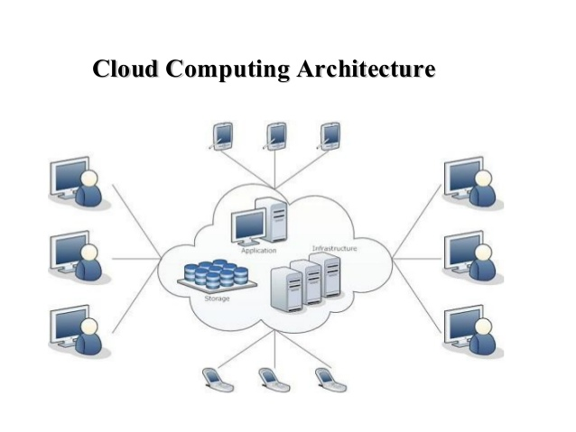

Slide 6
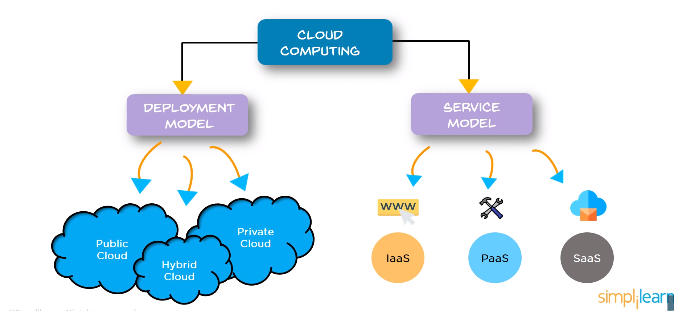
Types of cloud computing

Slide 7
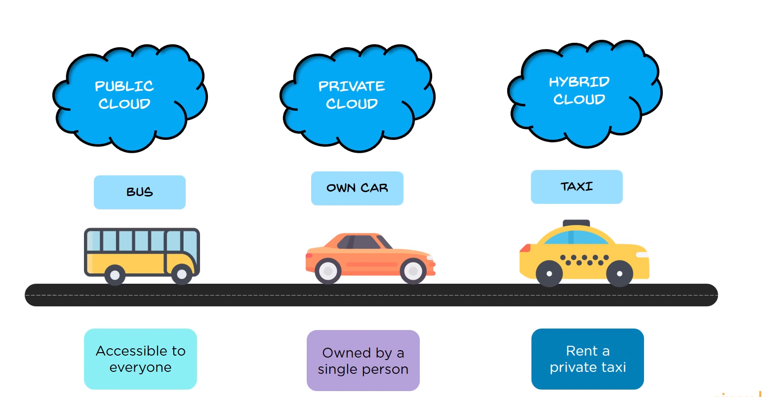
Deployment Models
Deployment models define the type of access to the cloud.
Types of access:
Public,
Private and
Hybrid

Slide 8
PUBLIC CLOUD : The Public Cloud allows systems and services to be easily accessible to the general public. Public cloud may be less secure.
PRIVATE CLOUD : The Private Cloud allows systems and services to be accessible within an organization. It offers increased security because of its private nature.
HYBRID CLOUD : The Hybrid Cloud is mixture of public and private cloud. However, the critical activities are performed using private cloud while the non-critical activities are performed using public cloud.

Slide 9
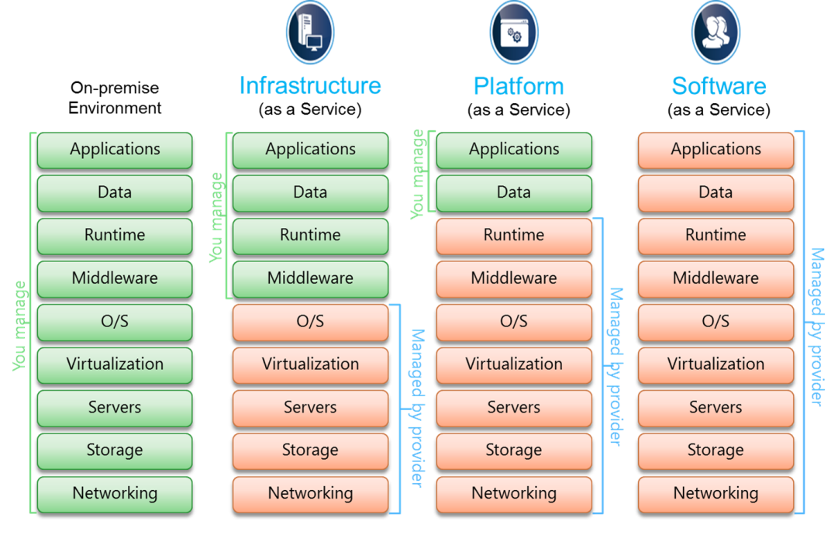
Service Models
1.Infrastructure as a Service (IaaS)
2. Platform as a Service (PaaS)
3. Software as a Service (SaaS)

Slide 10
Infrastructure as a Service (IaaS)
IaaS is the delivery of technology infrastructure as an on demand scalable service.
provides access to fundamental resources such as physical machines, virtual machines, virtual storage, etc.
•Usually billed based on usage
•Can be coupled with Managed Services for OS and
application support.

Slide 11
Platform as a Service (PaaS)
PaaS provides the runtime environment for applications, development & deployment tools, etc.
PaaS provides all of the facilities required to support the complete life cycle of building web applications and services from the Internet.

Slide 12
Software as a Service (SaaS)
SaaS model allows to use software applications as a service to end users.
SaaS is a software delivery methodology that provides access to software and its functions remotely as a Web-based service.
• Usually billed based on usage
• Highly scalable architecture

Slide 13
Advantages
• Lower computer costs
• Improved performance
• Reduced software costs
• Instant software updates
• Unlimited storage capacity
• Increased data reliability
• Easier group collaboration
• Device independence

Slide 14
Disadvantages
• Requires a constant Internet connection
• Does not work well with low-speed connections
• Features might be limited
• Can be slow
• Stored data can be lost
• Stored data might not be secure

Slide 15


